Slide 1
Majlis Ansarullah
Monthly Meeting
July 2016
This slide deck contains images licensed for the purpose of this presentation only.
No one is permitted to use the images for any other use, without prior permission.

Slide 2
AGENDA
Recitation of the Holy Qur’an (31:18-20)
Pledge
Reminders: Recitation of the Holy Qur’an and Congregational Prayers
Monthly topic: Does Our Ego Hurt Our Marriage?
Health topic: Smoking
National Reminders/announcements
Local Reminders/announcements
Dua

Slide 3
Why read the Holy Qur’an regularly?
ALL THE GOOD LIES IN Qur’an
The real and perfect paths of salvation have been opened only by the Holy Qur’an; all others were only its shadows. Therefore, you should study this Holy Scripture with the utmost attention and deepest thought and you should love it as you have never loved anything else. For indeed, as God conveyed to me,
“AL-KHAIROU KULLUHU FIL Qur’an”
i.e., All the good lies in the Qur’an.
(Our Teaching, Page 25)

Slide 4
Watching Our Congregational Salat!
Congregational Prayers with Rewards & Blessings in Fajr and Isha Prayers
Sayyidna Usman, (ra), has reported that he heard the Holy Prophet (saw) say: “The person who observes the Isha prayer in congregation, will have the reward and blessings of staying up half the night in prayer, and the one who observes the Fajr prayer in congregation will have the reward and blessings of staying up the whole night in prayer.”
(Tirmidhi)

Slide 5
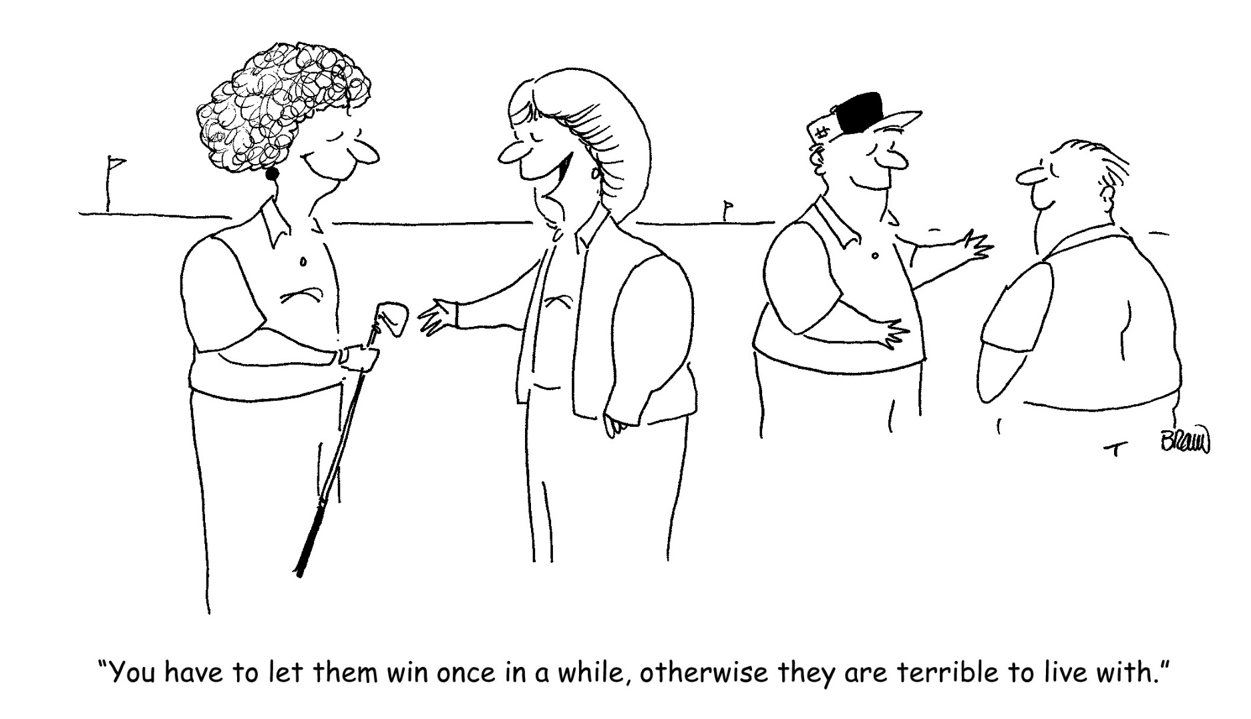
Is Our Ego Hurting Our Marriage?

Slide 6

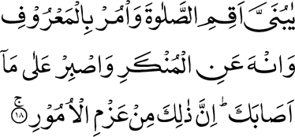
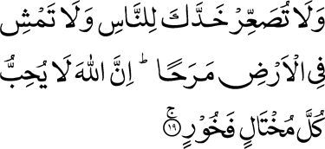
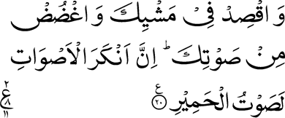
Click to listen the recitation
[31:18] O my dear son! observe Prayer, and enjoin good, and forbid evil, and endure patiently whatever may befall thee. Surely this is of those matters which require firm resolve.
[31:19] And turn not thy cheek away from men in pride nor walk in the earth haughtily; Surely, Allah loves not any arrogant boaster.
[31:20] And walk thou at a moderate pace, and lower thy voice; verily, the most disagreeable of voices is the voice of the ass.

Slide 7
Is Hazrat Luqman’s (alaihissalam) advice to his son still relevant in today’s age and time?
Share your thoughts

Slide 8
Hazrat Musleh Mau’ud (ra) explains:
When a man comes to acquire firm faith in God, and His powers and His attributes, and engages himself in Prayer, and exhorts other men to do good and right actions, and also patiently puts up with abuse and persecution, which he has to face, in the discharge of his difficult task, a new world opens to him. God inspires him with His love and as a result people flocks to him in large numbers. Then he is likely to be self-conceited and self-centered. Hence Luqman’s warning to his son to be on his guard against this moral lapse.
Five Volume Commentary, page 2083

Slide 9
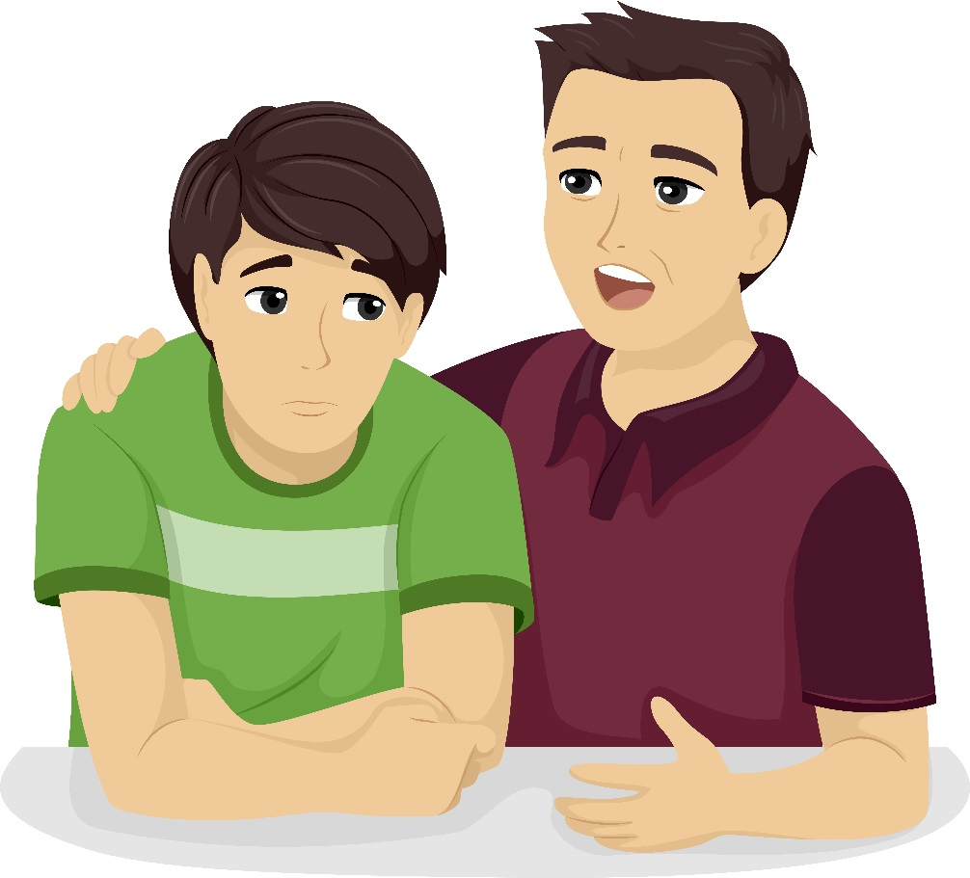
Discussion I
Your son in his early twenties tells you that he heard that women are more prone to flaws like backbiting and gossiping, etc. He further mentioned to you that when he marries, he will try to correct any such existing flaws in his wife even if he has to become harsh with her. How should you advise your son?

Slide 10
  Option 1: He is mature enough and has a great plan so you should encourage him to go with his plan.
  Option 2: You should explain to him that both men and women can have flaws and help each other overcome these weaknesses with love and patience.
  Option 3: His demeanor shows ego so you should share with him Hazrat Luqman’s (alaihissalam) advice to his son (31:18-19).
  Option 4: Any other advice.
Notes:
To what extent will you go to offer salat in congregation?

Slide 11
Guidance from the Holy Prophet (saw)
Hazrat Abu Huraira (ra) narrated that Holy Prophet Muhammad (saw) said,
"The strong is not the one who overcomes the people by his strength, but the strong is the one who controls himself while in anger”
Sahih al-Bukhari Book 78, Hadith 141

Slide 12

Discussion II
I gave a speech at my local Jama’at general meeting on the topic of ‘brotherhood and peace in the society.’ After the meeting was over, my wife’s brother became upset with me regarding my speech and blamed me of not practicing what I preached in my speech. He strongly objected and threatened to complain to the Jama’at President about my ill treatment of my wife at home. How should I respond?

Slide 13
  Option 1: I should raise my voice and yell at him until he retracts his accusations.
  Option 2: I should turn away from him saying ‘peace’ and don’t pay any attention to what he said.
  Option 3: I should analyze his blame and try to correct myself if there is any truth to it.
  Option 4: Any other response

Slide 14
Guidance from the Promised Messiah
The Promised Messiah (alaihissalam) says,
Whosoever does not live with his wife and her relations with gentleness, goodness, and magnanimity, he is not of my community. Whosoever deprives his neighbor of the very least good in his power, he is not of my community. Whosoever has no wish to forgive the faults of those who may have transgressed against him, and desires to nurse malice, he is not of my community. Every man or woman who is dishonest towards his or her spouse is not of my community.
(Our Teaching)

Slide 15
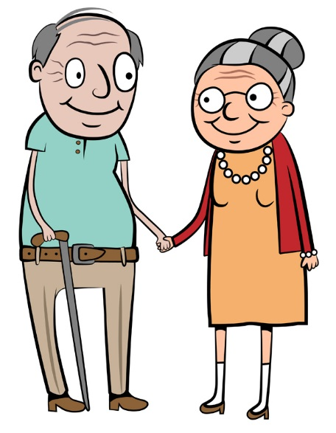
In the early years of our marriage, my wife unjustly complained to her parents about my ill treatment towards her. Her parents harshly confronted me without listening to my side. Regardless, I apologized. Later on, when I talked to my wife about this, realizing her mistake, she apologized. This incident was never repeated. My parents-in-law are now old and need our help. However, I don’t want to help them because they unjustly doubted me earlier. Am I justified in doing so?
Discussion III

Slide 16
  Option 1: I think I am justified as they might repeat their attitude of unnecessarily doubting me again.
  Option 2: I am still waiting for an apology from them. Once they do so, I am ready to help them.
  Option 3: I should exercise forgiveness and help them in their hour of need.
  Option 4: Any other response.

Slide 17
Guidance from the Promised Messiah
The Promised Messiah (alaihissalam) writes:
‘God wills that your person goes through a great revolutionary change and He demands a kind of death from you after which He will give you life! Reconcile with each other and forgive the sins of your brothers because mischievous is one who is not inclined to reconcile with his brother. He will be cut off because he creates divisions. Forsake every aspect of self-centeredness and let go of mutual discord. Humble yourself like a liar although you are truthful, so that you may be forgiven. Give up the bulkiness of self-centeredness because a big-headed person cannot enter through the door to which you have been called.’
(Kishti e Nuh, Ruhani Khaza’in Vol. 19, p. 12)

Slide 18
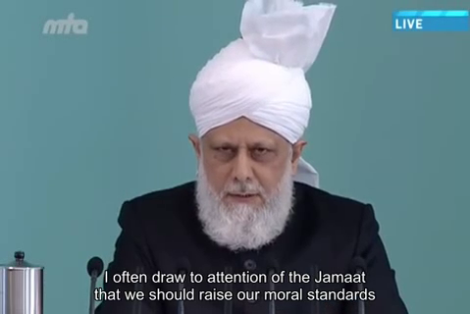
A Short Video from Friday Sermon, Oct. 10, 2014

Slide 19
Translation of the Video
I often draw to attention of the Jama’at that we should raise our moral standards and not get entangled in egotism over trivial matters. Each member of the Jama’at should try and become a model of morality and humanity. Indeed, sometimes we spill out our emotions and become angry. It is human nature but God has also given some commandments to true believers. We should control our emotions and express them according to the will of God. I have given an example of marital issues between husband and wife. So see, in the Qur’anic verses recited during the Nikah sermon, how Allah Ta’ala has given a variety of commandments with righteousness in view and it is essential for both husband and wife to act upon them. However, people often do not pay attention to those commandments. They only think that Nikah and Shaadi is done and that’s it. They who show rigidity in their matters, rather take pride in it. And instead of keeping those commandments in front of them, when problems arise, they keep sticking to their own stance. They feel pride in sticking to their stance and demeaning the other party. They deem their sentiments as right and have no consideration for the sentiment of others. They think that whatever they have done is right because in their mind the other persons got what they deserved. According to them, there was no other way except what they did. If the stance of such people is accepted then it means that the religion which they believe in, is false because religion says one thing and they say quite the other. They can of course say that it is difficult for them to abide by a particular commandment of religion but to believe that without breaking this commandment and without doing what they have done, there was no other way, is equivalent to falsifying the religion.

Slide 20
Where do we stand?
اپنے جائزے لیں -
Self-analyze yourself
In the last month, how many times, you yelled at your wife justifiably or unjustifiably?
How many times, did you yell at your children?
How many times, did you argue with a colleague or Jama’at friend?
Add the three numbers together.
(Keep it to yourself... the “score” is for you!)

Slide 21
How to Improve?
اپنے اندر پاک تبدیلیاں پیدا کریں -
Bring about pious changes in yourself
0
1-5
>5
Keep increasing in your faith in Allah and in your gentle treatment with your family and friends
Try to control your anger with prayers. Next time, don’t yell at your family member even if they are at fault.
Nothing wrong to get anger control treatment. Discuss options with your trusted friends in Jama’at or family.

Slide 22
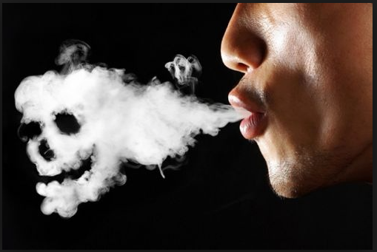
Health Topic: Smoking

Slide 23
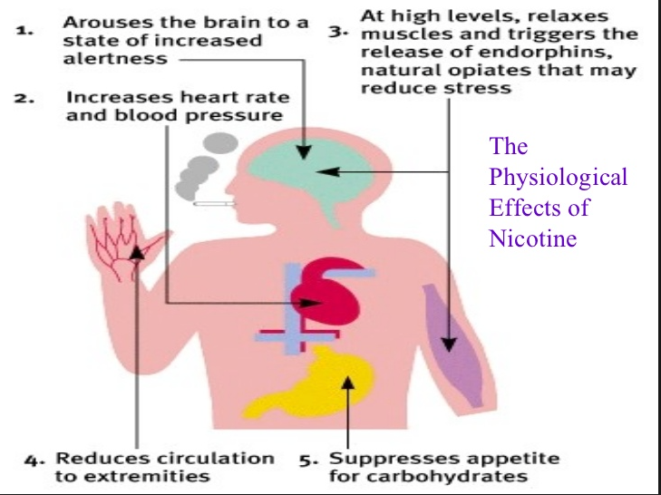
Why do we smoke?
All forms of tobacco - cigarettes, cigars, pipe, snuff and chewing tobacco - contain the addictive drug nicotine
Nicotine is readily absorbed into the bloodstream and causes increased alertness, raised blood pressure, decreased appetite and induces a sense of well being (Euphoria)
The harmful affects are innumerable and worsen with length and amount used

Slide 24
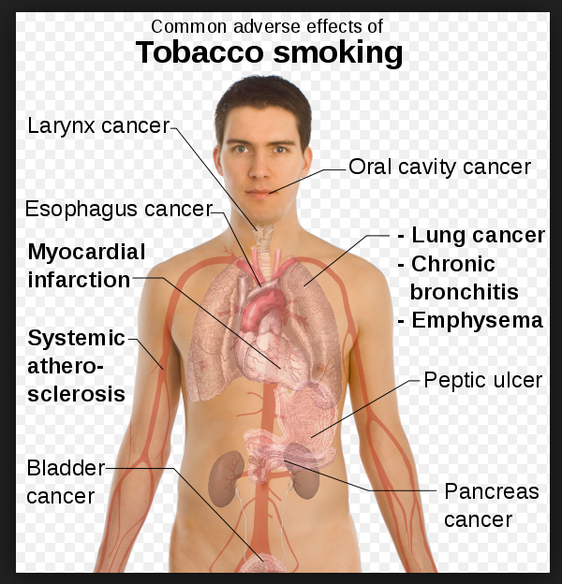
What does Tobacco do to you?
Increased risk of cataract, macular degeneration
Loss of Sense of Taste
COPD
Heart Disease
Diseases of blood vessels
Cancers
Wrinkles & Premature Aging
Increased Risk of Diabetes
Ulcers
Poor Oral and Dental health

Slide 25
How do I Stop?
Tobacco addiction is a chronic disease that often requires multiple attempts to quit, Most People would need a combination of medication with counseling to stop smoking
Behavioral Treatments teaches tobaccos users to recognize high-risk situations and develop coping skills to deal with them
Nicotine replacement therapies (NRTs) include nicotine chewing gum, nicotine patch, nasal sprays, inhalers, and lozenges. They deliver a small and controlled dose of nicotine to ease the withdrawal symptoms during the cessation process
Bupropion and varenicline are two medications that help to quit smoking. Working on the brain they ease withdrawal symptoms and block the effects of nicotine if people resume smoking
New Research is looking at Vaccines and newer drugs

Slide 26
National Reminders
Four Priorities for 2016
At least 50% of Tajnid to attend monthly meetings where we discuss our Khalifa’s vision: “Save yourself and your families from a fire” in interactive discussions.
Help establish a culture of congregational Salat.
Help strengthen the love of Holy Quran.
More than 50% Tajnid to attend National Ijtima. The National Ijtema and Shura will take place in BRM on Sep 23-25, 2016. Please start planning now

Slide 27
Local Reminders
Local Reminders
  Ta'lim Test I is due by Sunday, July 10, 2016.
Dua

